Slide 1
Introduction to Computer Simulation of Physical Systems
(Lecture 3)
Simulating Particle Motion
PHYS 3061

Slide 2
The class WalkerApp displays the distribution of values of the displacement x after N steps.
One way of determining the number of times that the variable x has a certain value would be to define a one-dimensional array, probability, and let probability[x] += 1;
Any problems with this implementation?

Slide 3
In this case because x takes only integer values, the array index of probability is the same as x itself.
However, the above statement does not work in Java because x can be negative as well as positive.
What we need is a way of mapping the value x to a bin or index number.
The HistogramFrame class, which is part of the Open Source Physics display package, does this mapping automatically using the Java Hashtable class.

Slide 4
In simple data structures data is accessed by an index that indicates the location of the data in the data structure.
Hashtable data is accessed by a key, which in our case is the value of x.
A hashing function converts the key to an index.
The append method of the HistogramFrame class takes a value, finds the index using a hashing function, and then increments the data associated with that key.
The HistogramFrame class also draws itself.

Slide 5
The HistogramFrame class is very useful for taking a quick look at the distribution of values in a data set.
You do not need to know how to group the data into bins or the range of values of the data.
The default bin width is unity, but the bin width can be set using the setBinWidth method.

Slide 6
See WalkerApp for an example of the use of the HistogramFrame class.
Frequently, we wish to use the histogram data to compute other quantities.
You can collect the data using the Data Table menu item in HistogramFrame and copy the data to a file.
Another option is to include additional code in your program to analyze the data.
For more details, you can read the text book.

Slide 7
Further practice
Compute P_{N}(x), the probability that the displacement of the walker from the origin is x after N steps.
What is the difference between the histogram, that is, the number of occurrences, and the probability?
  Consider N = 10 and N = 40 and at least 1000 trials.
Does the qualitative form of P_{N}(x) change as the number of trials increases?
What is the approximate width of P_{N}(x) and the value of P_{N}(x) at its maximum for each value of N?

Slide 8
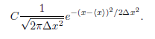
What is the approximate shape of the envelope of P_{N}(x)?
Does the shape change as N is increased?
Fit the envelope P_{N}(x) for sufficiently large N to the continuous function.

Slide 9
This form is the standard form of the Gaussian distribution with C = 1.
The easiest way to do this fit is to plot your results for P_{N}(x) and the form on the same graph using your results for ⟨x⟩ and Δx² as input parameters.
Visually choose the constant C to obtain a reasonable fit.
The lab 1, you will be asked to implement a more complicated random walk model, like 3D, uneven step size….
For more topics in random walk, you can also read the text book.

Slide 10
Method of Least Squares
The most common method for finding the best straight line fit to a series of measured points is called linear regression or least squares.
Suppose we have n pairs of measurements (x1, y1), (x2, y2), . . . , (xn, yn) and that the errors are entirely in the values of y.
For simplicity, we assume that the uncertainties in {yi} all have the same magnitude.
Our goal is to obtain the best fit to the linear function
  y = mx + b.

Slide 11
The problem is to calculate the values of the parameters m and b for the best straight line through the n data points.
The difference,
  d_{i} = y_{i} − mx_{i} − b
is a measure of the discrepancy in y_{i}.

Slide 12
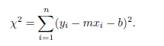
It is reasonable to assume that the best pair of values of m and b are those that minimize the quantity
Why should we minimize the sum of the squared differences between the experimental values, yi, and the analytical values, mx_{i}+b, and not some other function of the differences?

Slide 13
The justification is based on the assumption that if we did many simulations or measurements,
  the values of d_{i} would be distributed according to the Gaussian distribution.
Based on this assumption, it can be shown that the values of m and b that minimize χ yield a set of values of mx_{i} +b that are the most probable set of measurements that we would find based on the available information.

Slide 14
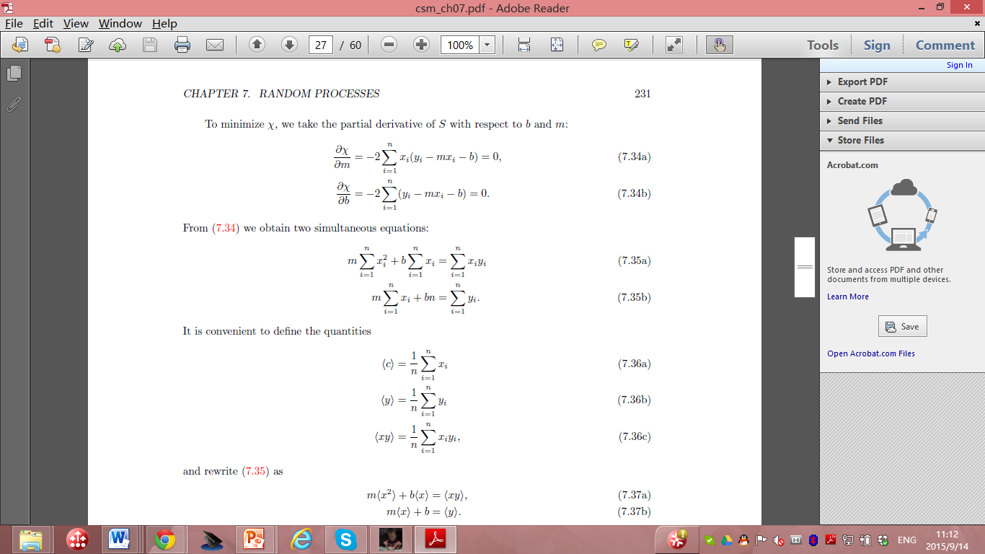
To minimize χ, we take the partial derivative with respect to b and m:

Slide 15
Then we obtain two equations:

Slide 16

It is convenient to define the quantities

Slide 17
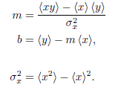
Rewrite the equation set as:
  m⟨x²⟩ + b⟨x⟩ = ⟨xy⟩, m⟨x⟩ + b = ⟨y⟩.
The solution is:
Where:

Slide 18
the slope m and the intercept b of the best straight line through the n data points.
Example: consider the data shown in Table on next page for a one-dimensional random walk.
To make the example more interesting, suppose that the walker takes steps of length 1 or 2 with equal probability. The direction of the step is random and p = 1/2.

Slide 19
N Δx²
8 19.43
16 37.65
32 76.98
64 160.38
assume that the mean square displacement Δx² obeys the general relation Δx² = aN^{2γ},
  with an unknown exponent ν and a is a constant.
  Note that the fitting problem is nonlinear, that is,
Often a problem that looks nonlinear can be turned into a linear problem by a change of variables.
In this case we convert the nonlinear relation to a linear relation by taking the logarithm of both sides:
  ln(Δx²) = ln a + 2ν lnN.

Slide 20
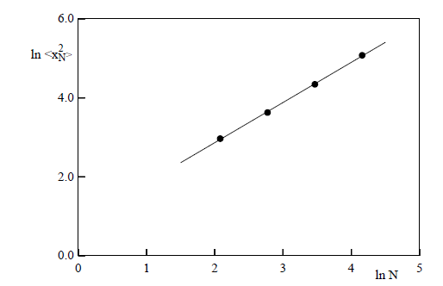
m = 1.02 and b = 0.83.
Hence, we conclude from our limited data and the relation 2ν = m that ν ≈ 0.51, which is consistent with the expected result ν = 1/2.

Slide 21

Random Number sequences
So far we have used the random number generator supplied with Java.
In principle, we could have generated these numbers from a random physical process, such as the decay of radioactive nuclei (refer to the text book for detailed discussions) or the thermal noise from a semiconductor device.
In practice, random number sequences are generated from a physical process only for specific purposes such as a lottery.

Slide 22
Although we could store the outcome of a random physical process so that the random number sequence would be both truly random and reproducible, such a method would usually be inconvenient and inefficient in part because we often require very long sequences.
  Any example of such random number generators in quantum physics?
In practice, we use a digital computer, a deterministic machine, to generate sequences of pseudorandom numbers.

Slide 23
such a distinction is unimportant if the sequence satisfies all our criteria for randomness.
  Although these sequences cannot be truly random
Common to refer to random number generators
  even though we really mean pseudorandom number generators.

Slide 24
Most random number generators yield a sequence
  in which each number is used to find the succeeding one according to a well defined algorithm.
  The most important features of a desirable random number generator:
    its sequence satisfies the known statistical tests for randomness,
    https://csrc.nist.gov/projects/random-bit-generation
We also want the generator to be efficient and machine independent, and the sequence to be reproducible. (WHY?)

Slide 25
The most widely used random number generator:
  linear congruential method.
One advantage
  very fast.
For a given seed x0, each number in the sequence is determined by the one-dimensional map.
  x_{n} = (ax_{n−1} + c) mod m

Slide 26
  x_{n} = (ax_{n−1} + c) mod m
where a, c, and m as well as x_{n} are integers
The notation y = z mod m means that m is subtracted from z until 0 ≤ y < m.
the multiplier a, the increment c, and the modulus m
  What’s the maximum possible period?

Slide 27
In general, the period depends on all three parameters.
  For example, if a = 3, c = 4, m = 32, and x0 = 1, the sequence : 1, 7, 25, 15, 17, 23, 9, 31, 1, 7, 25,
The period is 8
  rather than the maximum possible value of m = 32.
If we choose a, c, and m carefully such that the maximum period is obtained,
  then all possible integers between 0 and m − 1 would occur in the sequence.

Slide 28
To have random numbers r in the unit interval 0 ≤ r < 1 rather than random integers, random number generators usually return the ratio x_{n}/m
  which is always less than unity.
  Several rules have been developed to obtain the longest period.

Slide 29
Another popular random number generator:
  the generalized feedback shift register method,
  bit manipulation.
  Every integer is represented as a series of 1s and 0s called bits.
  These bits can be shuffled by using the bitwise exclusive or operator ⊕ (xor) defined by a ⊕ b = 1 if the bits a≠ b; a ⊕ b = 0 if a = b.
  The nth member of the sequence is given by
    x_{n} = x_{n−p} ⊕ x_{n−q},

Slide 30
In Java and C the exclusive or operation on the integers m and n is written as mˆn.
The algorithm for producing the random numbers after p integers have been produced:
  Initially the index, k, can be set to 0.
  1. If k < q, set j = k + q, else set j = k − p + q.
  2. Set x_{k} = x_{k} ⊕ x_{j} ; x_{k} is the desired random number for this iteration.
  If a random number between 0 and 1 is desired, divide x_{k} by the maximum possible integer that the computer can hold.
  3. Increment k to (k + 1) mod p.

Slide 31
Because the exclusive or operator and bit manipulation is very fast,
  this random number generator is very fast.
  However, the period may not be long enough for some applications and the correlations between numbers might not be as good as needed.

Slide 32
general nature:
  numbers in the sequence are used to find the succeeding ones according to a well defined algorithm.
  The sequence is determined by
    the seed,
    the first number of the sequence,
    or the first p members of the sequence for the generalized feedback shift register and related generators.
  Usually, the maximum possible period is related to the size of the computer word,
  for example, 32, or 64 bits.
  The choice of the constants and the proper initialization of the sequence is very important and thus these algorithms must be implemented with care.

Slide 33
no necessary and sufficient test for the randomness of a finite sequence of numbers;
  It is apparently random.
  Because no single statistical test is a reliable indicator, we need to consider several tests.
  For details of the statistical tests, please read the textbook.

Slide 34
Many of these tests can be stated in terms of random walks.
  Random walk. A test based on the properties of random walks has been proposed by Vattulainen et al.
    Phys. Rev. Lett. 73, 2513 – Published 7 November 1994
  Assume that a walker begins at the origin of the x-y plane and walks for N steps.

Slide 35
  Average over M walkers and count the number of walks that end in each quadrant qi.
    divided into four equal blocks, each of which has an equal probability to contain the random walker after a walk of length n.
  The test is performed N times, and the number of occurrences in each of the four blocks is compared to the expected value of N/4, using a test with three degrees of freedom.
  The generator fails if the χ2 value exceeds 7.815 in at least two out of three independent runs. This should occur with a probability of only about 3/400.

Slide 36
Variational Methods
Many problems in physics can be formulated in terms of a variational principle.
How Monte Carlo methods can be applied to these problems?
A more sophisticated application of Monte Carlo methods to a variational problem in quantum mechanics will be discussed in the Monte Carlo chapter in PHYS4061.

Slide 37
Light rays
  This description of light propagation, called geometrical or ray optics, is applicable when the wavelength of light is small compared to the linear dimensions of any obstacles or openings.
  The path of a light ray can be formulated in terms of Fermat’s principle of least time: A ray of light follows the path between two points (consistent with any constraints) that requires the least amount of time.
Fermat’s principle can be adopted as the basis of geometrical optics.

Slide 38
For example, Fermat’s principle implies that light travels from a point A to a point B in a straight line in a homogeneous medium.
Because the speed of light is constant along any path within the medium, the path of shortest time is the path of shortest distance,
  that is, a straight line from A to B.
What happens if we impose the constraint that the light must strike a mirror before reaching B?

Slide 39
The speed of light in a medium can be expressed in terms of c, the speed of light in a vacuum, and the index of refraction n of the medium : v =c / n
Suppose that a light ray in a medium with index of refraction n₁ passes through a second medium with index of refraction n₂.
The two media are separated by a plane surface.
We now show how we can use Fermat’s principle and a simple Monte Carlo method to find the path of the light.
The analytical solution to this problem using Fermat’s principle is found in many texts.

Slide 40
Our strategy, as implemented in class Fermat, is to begin with a straight path and to make changes in the path at random.
These changes are accepted only if they reduce the travel time of the light.

Slide 41
Some of the features of Fermat and FermatApp include:
1. Light propagates from left to right through N regions.
  The index of refraction n[i] is uniform in each region [i].
  The index i increases from left to right.
  We have chosen units such that the speed of light in vacuum equals unity.
2. Because the light propagates in a straight line in each medium, the path of the light is given by the coordinates y[i] at each boundary.
3. The coordinates of the light source and the detector are at (0,y[0]) and (N,y[N]) respectively, where y[0] and y[N] are fixed.

Slide 42
4 The path is the connection of the set of points at the boundary of each region.
5. The path of the light is found by choosing the boundary i at random and generating a trial value of y[i] that differs from its previous value by a random number between -dy to dy.
  If the trial value of y[i] yields a shorter travel time, this value becomes the new value for y[i].
6. The path is redrawn whenever it is changed.

Slide 43
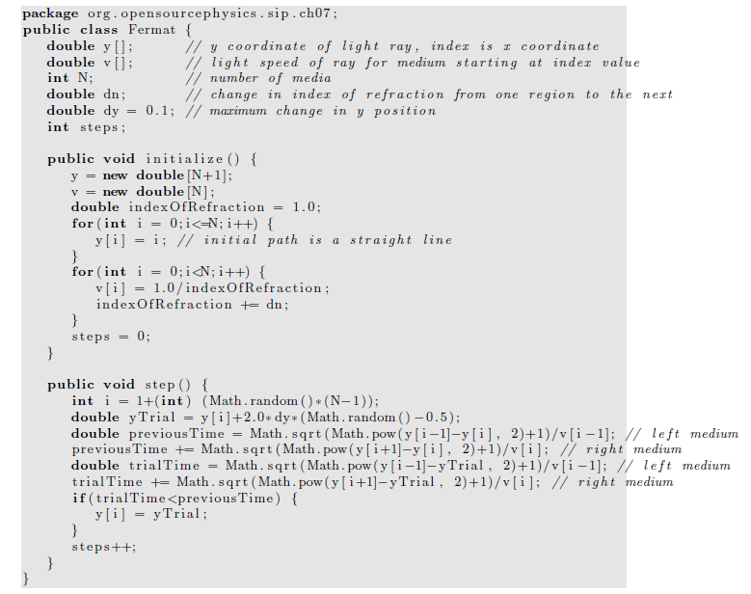

Slide 44
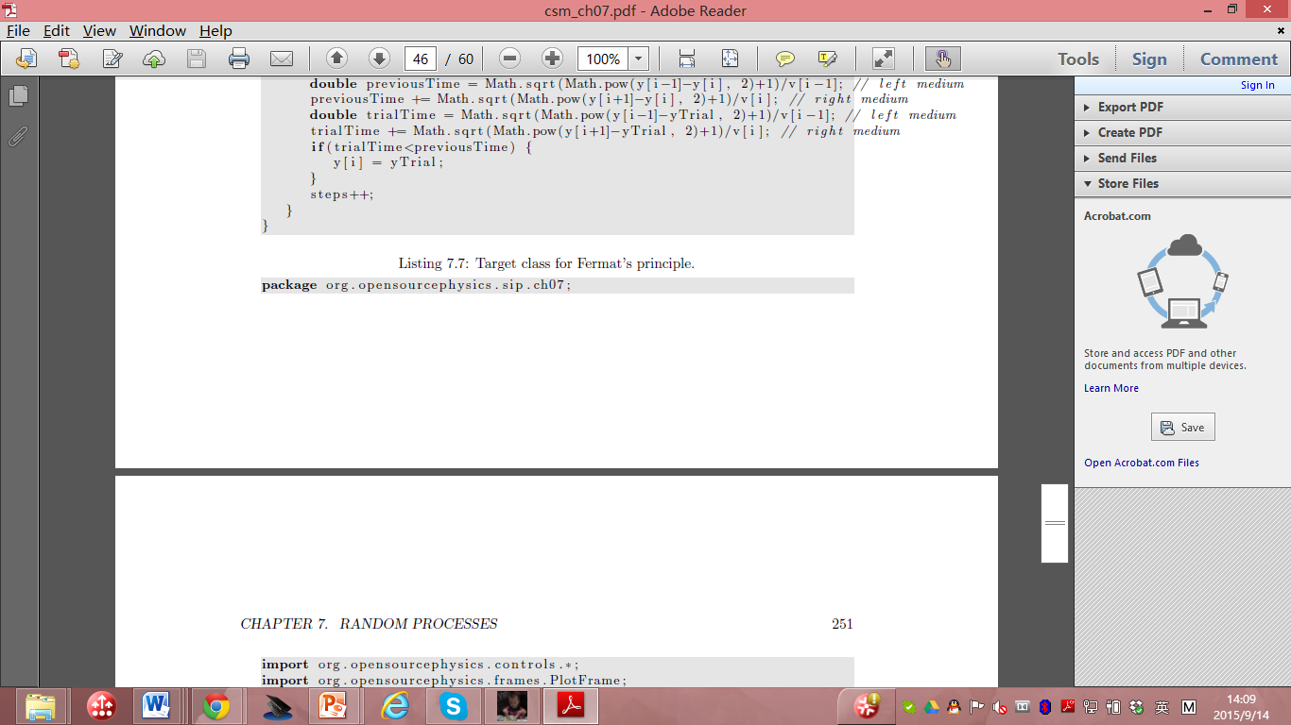

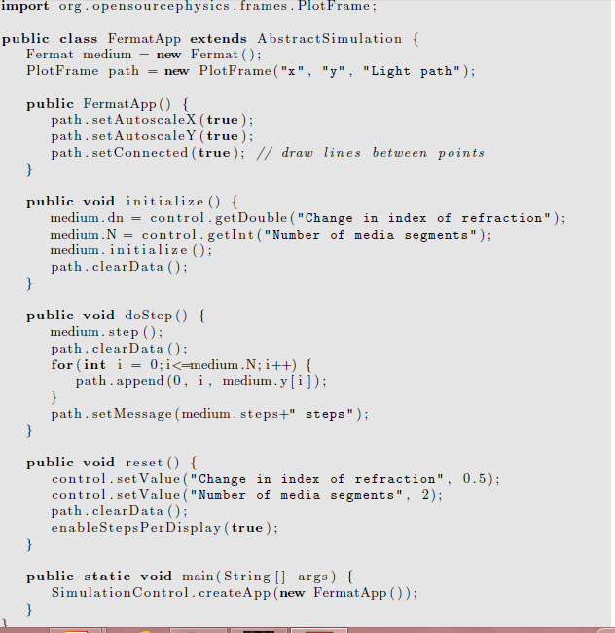

Slide 45
Modified Euler algorithms
Simple Euler algorithm is insufficient
  The Euler algorithm assumes that the velocity and acceleration do not change significantly
    during the time step Δt.
  To achieve an acceptable numerical solution, Δt must be chosen to be sufficiently small!
    What kind of physical systems may have large coupling between velocity and acceleration?
However, if we make Δt too small, we run into several problems.
  Can you spot a few?

Slide 46
more and more iterations,
  the round-off error accumulates
    due to the finite precision of any floating point number
  eventually the numerical results will become inaccurate.
  Any solution on this?
The greater the number of iterations,
  the greater the computer time required for the program to finish.
Unstable for many systems,
  the errors accumulate exponentially,
  the numerical solution becomes inaccurate very quickly.
  Any solutions you can imagine to solve this problem?
For these reasons more accurate and stable numerical algorithms are necessary.

Slide 47
To illustrate why we need algorithms other than the simple Euler algorithm
  a very simple change in the Euler algorithm:
  v(t + Δt) = v(t) + a(t)Δt
  y(t + Δt) = y(t) + v(t + Δt)Δt,
The only difference between this algorithm and the simple Euler:
  v(t + Δt) = v(t) + a(t)Δt
  y(t + Δt) = y(t) + v(t)Δt,
  the computed velocity at v(t + Δt),
  is used to compute the new position, y(t + Δt)
  In what systems the latter velocity is generally more accurate?

Slide 48
this modified Euler algorithm is significantly better for oscillating systems.
We refer to this algorithm as
  the Euler-Cromer algorithm.

Slide 49
It would be better to compute the velocity at the middle of the interval
  rather than at the beginning or at the end.
The Euler-Richardson algorithm is based on this idea.

Slide 50
This algorithm is particularly useful for velocity-dependent forces
  but does as well as other simple algorithms for forces that do not depend on the velocity.
  The algorithm consists of using the Euler algorithm to find the intermediate position y_{mid} and velocity v_{mid} at a time t_{mid} = t + Δt/2.
We then compute the force, F(y_{mid}, v_{mid}, t_{mid}) and the acceleration a_{mid} at t = t_{mid}.
The new position y_{n+1} and velocity v_{n+1} at time t_{n+1} are found using v_{mid} and a_{mid} and the Euler algorithm.

Slide 51
Euler-Richardson algorithm:
a_{n} = F(y_{n}, v_{n}, t_{n})/m
v_{mid} = v_{n} +1/2 a_{n}Δt
y_{mid} = y_{n} +1/2 v_{n}Δt
a_{mid} = F(y_{mid}, v_{mid}, t +1/2 Δt)/m,
v_{n+1} = v_{n} + a_{mid}Δt
y_{n+1} = y_{n} + v_{mid}Δt

Slide 52
Although we need to do twice as many computations per time step,
the Euler-Richardson algorithm is much faster than the Euler algorithm
  because we can make the time step larger
  still obtain better accuracy than with either the Euler or Euler-Cromer algorithms
  What’s the fundamental idea of this algorithm?

Slide 53
Effects of Drag Resistance
A projectile on the surface of the Earth with no air friction,
  Including a plot of position versus time and an animation of a projectile moving through the air.

Slide 54
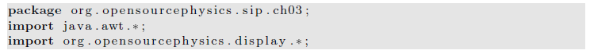
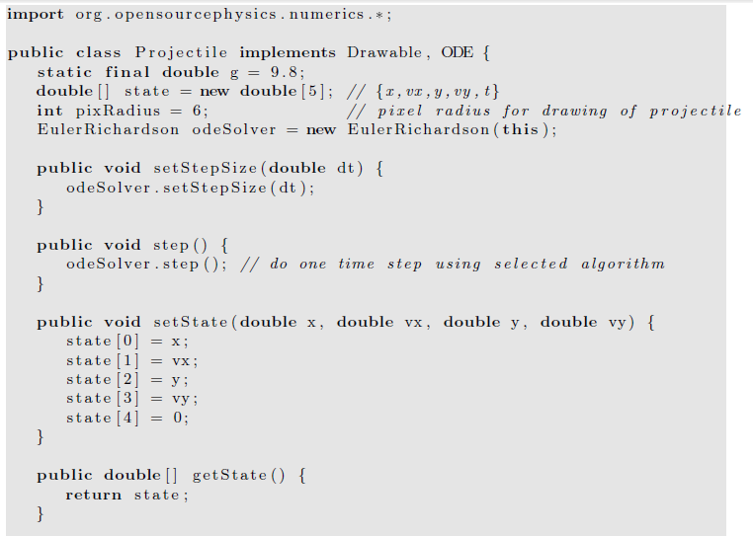

Slide 55
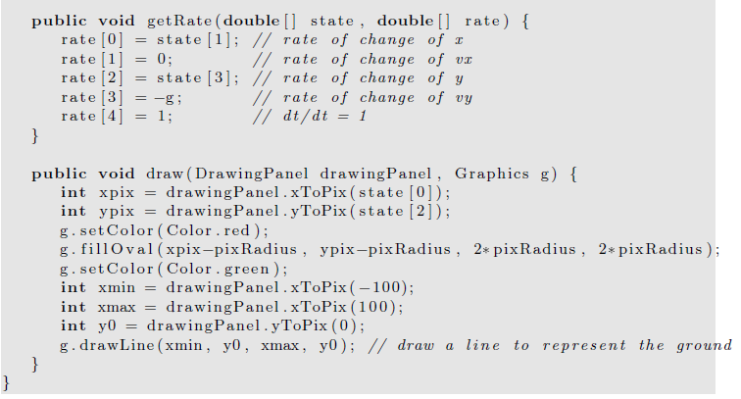

Slide 56
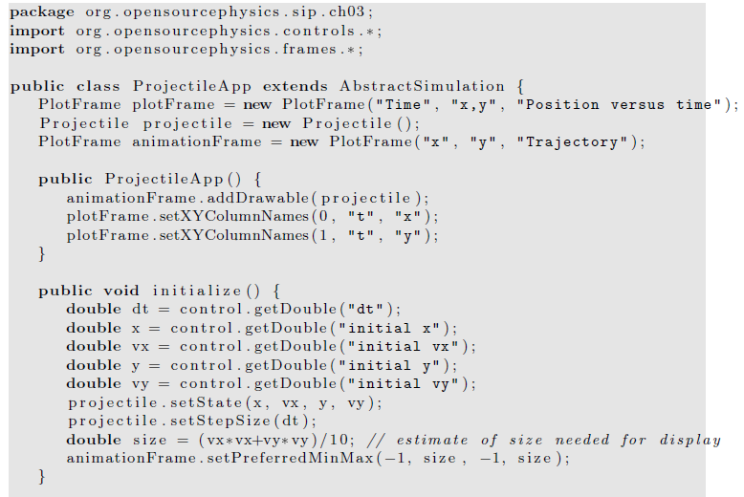

Slide 57
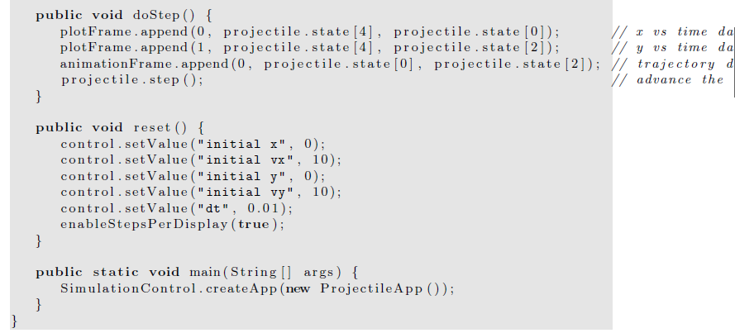

Slide 58
For particles near the Earth’s surface,
  an more important modification is to include the drag force due to air resistance.
  The direction of the drag force F_{d}(v) is opposite to the velocity of the particle
  For a falling body F_{d}(v) is upward
Hence, the total force F on the falling body can be expressed as
  F = -mg + F_{d}.
  What’s the final constant velocity?
  How can we measure the drag force?

Slide 59
The velocity dependence of F_{d}(v) is known theoretically
  in the limit of very low speeds for small objects.
In general, necessary to determine the velocity dependence of F_{d}(v) empirically over a limited range of velocities.
One way to obtain the form of F_{d}(v) is to measure y as a function of t
  and compute v(t) by calculating the numerical derivative of y(t).

Slide 60
Similarly we can use v(t) to compute a(t) numerically.
From this information it is possible in principle to find the acceleration as a function of v and to extract Fd(v).
  errors because the accuracy of the derivatives will be less than the accuracy of the measured position.
An alternative is to reverse the procedure
  assume an explicit form for the v dependence of Fd(v),
  use it to solve for y(t).
If the calculated values of y(t) are consistent with the experimental values of y(t),
  the assumed v dependence of Fd(v) is justified empirically.

Slide 61
The two common assumed forms of the velocity dependence of Fd(v) are
F_{1,d}(v) = C₁v,
F_{2,d}(v) = C₂v²,
the parameters C₁ and C₂ depend on the properties of the medium and the shape of the object.
  useful phenomenological expressions
    yield approximate results for F_{d}(v) over a limited range of v

Slide 62
Because F_{d}(v) increases as v increases,
  there is a limiting or terminal velocity (speed)
    the net force on a falling object is zero.
This terminal speed can be found by setting F_{d} = mg and is given by
v_{1,t} =mg/C₁ (linear drag)
v_{2,t} =(mg/C₂)^{1/2} (quadratic drag)

Slide 63
write F_{d} in the linear and quadratic cases as
F_{1,d} = C₁v_{1,t}( v / v_{1,t})= mgv/v_{1,t}
F_{2,d} = C₂v_{2,t}²( v/v_{2,t})²= mg( v/v_{2,t})²
the net force (per unit mass) on a falling object in the convenient forms
F₁ (v)/m= - g(1-v/v_{1,t})
F₂ (v)/m= -g(1- v²/v_{2,t}²)

Slide 64
Consider the fall of a pebble of mass m = 10⁻² kg.
To a good approximation, the drag force is proportional to v².
For a spherical pebble of radius 0.01 m, C₂ is found empirically to be approximately 10⁻² kg/m.
The terminal velocity to be about 30 m/s.

Slide 65
Two-Dimensional Trajectories
Consider an object of mass m
  whose initial velocity v₀ is directed at an angle θ₀ above the horizontal.
  The particle is subjected to gravitational and drag forces of magnitude mg and F_{d};
  the direction of the drag force is opposite to v.
Newton’s equations of motion for the x and y components of the motion can be written as
m dv_{x}/dt= -F_{d} cos θ
m dv_{y}/dt= -mg -F_{d} sin θ.

Slide 66
For example, let us maximize the range of a round steel ball of radius 4 cm.
A reasonable assumption for a steel ball of this size and typical speed is that F_{d} = C₂v².
Because v_{x} = v cos θ and v_{y} = v sin θ,
we can rewrite the equations in last page as
m dv_{x}/dt = -C₂vv_{x}
m dv_{y}/dt = -mg - C ₂vv_{y}.

Slide 67
Decay processes
The power of mathematics when applied to physics:
  seemingly unrelated problems frequently have the same mathematical formulation.
Hence, if we can solve one problem, we can solve other problems that might appear to be unrelated.
For example, the growth of bacteria, the cooling of a cup of hot water, the charging of a capacitor in a RC circuit, and nuclear decay all can be formulated in terms of equivalent differential equations.

Slide 68
Consider a large number of radioactive nuclei.
Although the number of nuclei is discrete,
  we often may treat this number as a continuous variable because the number of nuclei is very large.
In this case the law of radioactive decay
  the rate of decay is proportional to the number of nuclei.
Thus we can write
dN/dt= -λN,

Slide 69
dN/dt= -λN,
  where N is the number of nuclei and λ is the decay constant.
Of course, we do not need to use a computer to solve this decay equation,
  the analytical solution is N(t) = N₀e⁻ ^{λ t},
  where N₀ is the initial number of particles.
  The quantity λ has dimensions of inverse time.

Slide 70
Cooling of a cup of coffee
The nature of the energy transfer from the hot water in a cup of coffee to the surrounding air is complicated and in general involves the mechanisms of convection, radiation, evaporation, and conduction.
However, if the temperature difference between the water and its surroundings is not too large,
  the rate of change of the temperature of the water may be assumed to be proportional to the temperature difference.
We can formulate this statement more precisely in terms of a differential equation:
dT/dt= -r (T - T_{s})

Slide 71
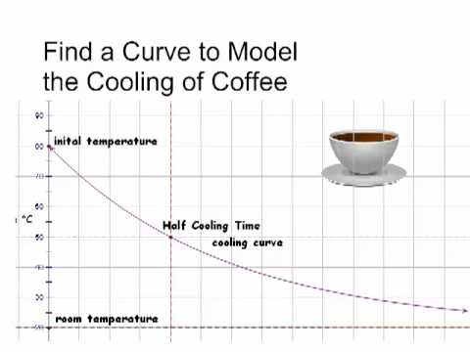
dT/dt= -r (T - T_{s})
  where T is the temperature of the water,
  T_{s} is the temperature of its surroundings, and r is the cooling constant.
  The minus sign implies that if T > T_{s}, the temperature of the water will decrease with time.
The value of the cooling constant r depends on the heat transfer mechanism,
  the contact area with the surroundings, and the thermal properties of the water.
The relation is sometimes known as Newton’s law of cooling, even though the relation is only approximate,
  and Newton did not express the rate of cooling in this form.

Slide 72
Numerical Integration of Newton’s Equation of Motion
several of the common finite difference methods for the solution of Newton’s equations of motion with continuous force functions.
The number and variety of algorithms currently in use is evidence that
  no single method is superior under all conditions.

Slide 73
Newton’s equations of motion in the form
dv/dt= a(t),
dx/dt= v(t)
The goal of finite difference methods is to determine the values of x_{n+1} and v_{n+1} at time t_{n+1} = t_{n} + Δt.
We already have seen that Δt must be chosen so that the integration method generates a stable solution.
If the system is conservative, Δt must be sufficiently small
  so that the total energy is conserved to the desired accuracy.

Slide 74
The nature of many of the integration algorithms can be understood by expanding
v_{n+1} = v(t_{n} + Δt) and x_{n+1} = x(t_{n} + Δt) in a Taylor series.
We write v_{n+1} = v_{n} + a_{n}Δt + O((Δt)²)
x_{n+1} = x_{n} + v_{n}Δt +1/2a_{n}(Δt)² + O((Δt)³)
The familiar Euler algorithm is equivalent to retaining the O(Δt) terms :
v_{n+1} = v_{n} + a_{n}Δt
x_{n+1} = x_{n} + v_{n}Δt. (Euler algorithm)

Slide 75
Because order Δt terms are retained, the local truncation error, the error in one time step, is order (Δt)².
The global error, the total error over the time of interest, due to the accumulation of errors from step to step is order Δt.
This estimate of the global error
  the number of steps into which the total time is divided is proportional to 1/Δt.
  Hence, the order of the global error is reduced by a factor of 1/Δt relative to the local error.
We say that an algorithm is nth order if its global error is order (Δt)^{n}.
The Euler algorithm is an example of a first-order algorithm.

Slide 76
The Euler algorithm is asymmetrical because it advances the solution by a time step Δt,
  But uses information about the derivative only at the beginning of the interval.
  We already have found that the accuracy of the Euler algorithm is limited and that frequently its solutions are not stable.
A simple modification yields solutions that are stable for oscillatory systems.
  Euler-Cromer
    Use v_{n+1}
  Midpoint algorithm
    use the mean velocity, ½ (v_{n}+v_{n+1})
    Second order accuracy!

Slide 77
Although the midpoint approximation yields exact results for constant acceleration, it usually does not yield much better results than the Euler algorithm.
In fact, both algorithms are equally poor, because the errors increase with each time step.

Slide 78
A higher order algorithm whose error is bounded is the half-step algorithm.
In this algorithm the average velocity during an interval is taken to be the velocity in the middle of the interval.
The half-step algorithm can be written as v_{n+1/2}= v_{n−1/2}+ a_{n}Δt,
x_{n+1} = x_{n} + v_{n+1/2}Δt. (half-step algorithm)

Slide 79
Note that the half-step algorithm is not self-starting,
  does not allow us to calculate v_{1/2}.
This problem can be overcome by adopting the Euler algorithm for the first half step:
V_{1/2}= v₀ +1/2a₀ Δt.
Because the half-step algorithm is stable, it is a common textbook algorithm!

Slide 80
The Euler-Richardson algorithm
x₁ ≈x(t + Δt) = x(t) + v(t)Δt +1/2a(t)(Δt)².
The notation x₁ implies that x(t+Δt) is related to x(t) by one time step.
We also may divide the step Δt into half steps and write the first half step, x(t + 1/2Δt), as
x(t +1/2Δt) ≈ x(t) + v(t)Δt²+1/2a(t)(Δt)²

Slide 81
The second half step, x₂(t + Δt), may be written as
x₂(t + Δt) ≈ x(t +1/2Δt) + v(t +1/2Δt)Δt²+1/2a(t +1/2Δt)(Δt/2)².

Slide 82
x₂(t + Δt) ≈x(t) +1/2[v(t) + v(t +1/2Δt)]Δt +1/2[a(t) + a(t +1/2 Δt)](1/2 Δt)²
Now a(t + 1/2Δt) ≈a(t) + 1/2a′(t)Δt.
Hence to order (Δt)², it becomes
x₂(t + Δt) ≈x(t) +1/2[v(t) + v(t +1/2Δt)]Δt +1/2[2a(t)](1/2 Δt)²

Slide 83
We can find an approximation that is accurate to order (Δt)³ by combining x1 and x2 so that the terms to order (Δt)² cancel.
The combination that works is 2x₂ - x₁, which gives the
Euler-Richardson result:
x_{er}(t + Δt) ≡2x₂(t+Δt)-x₁ (t+Δt)=x(t)+v(t+1/2Δt)]Δt +O (Δt)³
v_{er} ≡2v₂(t+Δt)-v₁ (t+Δt)=v(t)+a(t+1/2Δt)]Δt +O (Δt)³

Slide 84
A bonus of the Euler-Richardson algorithm is that the quantities |x₂ - x₁| and |v₂ - v₁| give an estimate for the error.
We can use these estimates to change the time step so that the error is always within some desired level of precision.

Slide 85
One of the most common drift-free higher order algorithms is commonly attributed to Verlet.
We write the Taylor series expansion for x_{n−1}
x_{n−1} = x_{n}- v_{n}Δt +1/2a_{n}(Δt)².

Slide 86
If we add the forward and reverse forms respectively, we obtain
x_{n+1} + x_{n−1} = 2x_{n} + a_{n}(Δt)² + O((Δt)⁴)
  Why can we do this?
or
x_{n+1} = 2x_{n}- x_{n−1} + a_{n}(Δt)². (leapfrog algorithm)
the subtraction of the Taylor series for x_{n+1} and x_{n−1} yields v_{n} = (x_{n+1} - x_{n−1})/2Δt (leapfrog algorithm)

Slide 87
Note that the global error associated with the leapfrog algorithm is third-order for the position and second-order for the velocity.
However, the velocity plays no part in the integration of the equations of motion.
The leapfrog algorithm is also known as the explicit central difference algorithm.
Because this form of the leapfrog algorithm is not self-starting, another algorithm must be used to obtain the first few terms.

Slide 88
An additional problem is that the new velocity is found by computing the difference between two quantities of the same order of magnitude.
  Really no good!
Such an operation results in a loss of numerical precision and may give rise to roundoff errors.

Slide 89
A mathematically equivalent version of the leapfrog algorithm is given by
x_{n+1} = x_{n} + v_{n}Δt +1/2a_{n}(Δt)²
v_{n+1} = v_{n} +1/2 (a_{n+1} + a_{n})Δt. (velocity Verlet algorithm)
the velocity form of the Verlet algorithm, is self-starting and minimizes roundoff errors.

Slide 90
Another useful algorithm that avoids the roundoff errors of the leapfrog algorithm is due to Beeman and Schofield.
We write the Beeman algorithm in the form:
x_{n+1} = x_{n} + v_{n}Δt +1/6(4a_{n} - a_{n−1})(Δt)²
v_{n+1} = v_{n} +1/6(2a_{n+1} + 5a_{n} - a_{n−1})Δt. (Beeman algorithm)

Slide 91
The most common finite difference method for solving ordinary differential equations is the Runge-Kutta method.
Because Runge-Kutta algorithms are self-starting, they are frequently used to obtain the first few iterations for an algorithm that is not self-starting.
For details, read the textbook because it has been covered in PHYS2061.

Slide 92
The Dynamics of Many Particle
Systems
We simulate the dynamical behavior of many particle systems such as dense gases, liquids, and solids and observe their qualitative features.
Some of the basic ideas of equilibrium statistical mechanics and kinetic theory are introduced.

Slide 93
Introduction
With the knowledge of the laws of physics at the microscopic level,
  how to understand the behavior of gases, liquids, and solids and more complex systems?
  such as polymers and proteins?
For example, consider two cups of water prepared under similar conditions.
Each cup contains approximately 1025 molecules which mutually interact and,
to a good approximation, move according to the laws of classical physics.

Slide 94
Although the intermolecular forces produce a complicated trajectory for each molecule, the observable properties of the water in each cup are indistinguishable and are easy to describe.
For example, the temperature of the water in each cup is independent of time even though the positions and velocities of the individual molecules are changing continually.

Slide 95
Although the intermolecular forces produce a complicated trajectory for each molecule,
  the observable properties of the water in each cup are indistinguishable and are easy to describe.
  For example, the temperature of the water in each cup is independent of time
    even though the positions and velocities of the individual molecules are changing continually.

Slide 96
One way to understand the behavior of a classical many particle system is to simulate the trajectory of each particle.
This approach, known as molecular dynamics, has been applied to various systems
  has given us much insight into a variety of systems in which the particles obey the laws of classical dynamics.

Slide 97
A calculation of the trajectories of many particles would not be very useful unless we know the right questions to ask.
Saving these trajectories would quickly fill up any storage medium, and we do not usually care about the trajectory of any particular particle.
  If God is a programmer, does he save all the history?
What are the useful quantities needed to describe these many particle systems?
What are the essential characteristics and regularities they exhibit?

Slide 98
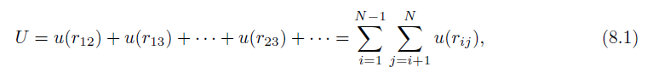
The Intermolecular Potential
We assume that the dynamics can be treated classically,
  the molecules are spherical
  and chemically inert
  and their internal structure can be ignored,
  and the interaction between any pair of particles depends only on the distance between them.
In this case the total potential energy U is a sum of two-particle interactions:

Slide 99
where u(r_{ij}) depends only on the magnitude of the distance r_{ij} between particles i and j.
The pairwise interaction form is appropriate for simple liquids such as liquid argon.
The form of u(r) for electrically neutral molecules can be constructed by a first principles quantum mechanical calculation.
Such a calculation is very difficult, and it usually is sufficient to choose a simple phenomenological form for u(r).
The most important features of u(r) are a strong repulsion for small r and a weak attraction at large r.

Slide 100
The repulsion for small r is a consequence of the Pauli exclusion principle.
  That is, the electron wave functions of two molecules must distort to avoid overlap, causing some of the electrons to be in different quantum states.
  What about other particles? Are there particles that can occupy the same state?
The net effect is an increase in kinetic energy and an effective repulsive interaction between the electrons,
  Known as core repulsion.
The dominant weak attraction at larger r is due to the mutual polarization of each molecule; the resultant attractive potential is called the van der Waals potential.

Slide 101
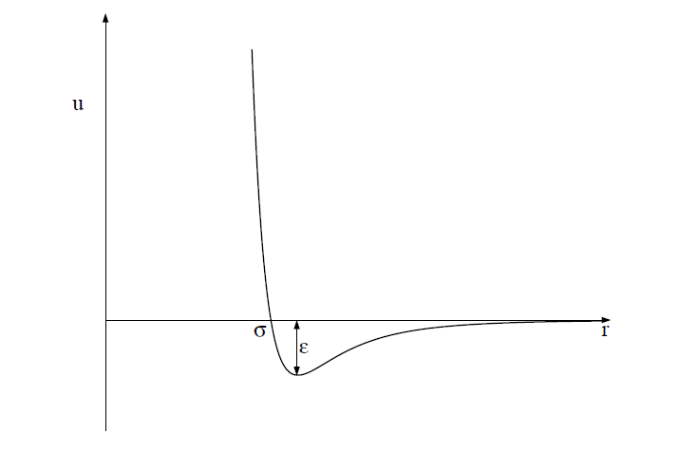
One of the most common phenomenological forms of u(r) is the Lennard-Jones potential:
u(r) = 4ϵ[(σ/r)¹²−(σ/r)⁶].

Slide 102
The r ⁻¹² form of the repulsive part of the interaction was chosen for convenience only and has no fundamental significance.
The attractive 1/r⁶ behavior at large r corresponds to the van der Waals interaction.
The Lennard-Jones potential is parameterized by a length σ and an energy ϵ.
Note that u(r) = 0 at r = σ, and that u(r) is close to zero for r > 2.5σ.
The parameter ϵ is the depth of the potential at the minimum of u(r); the minimum occurs at a separation r = 2^{1/6} σ.

